Slide 1

Dr. AMBEDKAR INSTITUTE OF TECHNOLOGY
An Autonomous Institution, Aided by Government of Karnataka
Near Jnana Bharathi Campus, Bengaluru-560056
PROJECT ON
“Credit Card Fraud Detection Using Machine Learning”
BACHELOR OF ENGINEEERING
IN
INFORMATION SCIENCE & ENGINEERING
2021-22
PRESENTED BY:
AMOGH D R [USN: 1DA18IS006]
RAHUL RAJAN [USN: 1DA18IS042]
Under the guidance of : Dr. Chandrakant G Pujari
Asst. Professor, Dept. of ISE
Dr. Ambedkar Institute of Technology

Slide 2
Table of Contents
1. Abstract
2. Introduction
3. Problem Statement
3.1 Fraud Detection
3.2 Fraud Detection Process
4. Technologies used
4.1 Machine Learning
4.2 Algorithm Used
5. Modules
6. Dataset for Credit Card Fraud Detection
7. Data Flow Diagram
8. Progress of Application
9. Advantage
10. Conclusion and Future Scope

Slide 3
1. Abstract
Due to cashless transaction, every people use ATM card and Credit card for transaction, so fraud can also be increased.
Billions of dollars of loss are caused every year by fraudulent credit card transactions.
The design of efficient fraud detection algorithms is key for reducing these losses, and more and more algorithms rely on advanced machine learning techniques to assist fraud investigators.

Slide 4
2. Introduction
The online shopping is growing day by day. Credit cards are used for purchasing goods and services with the help of virtual card and physical card where as virtual card for online transaction and physical card for offline transaction.
In a physical-card based purchase, the cardholder presents his card physically to a merchant for making a payment. If the cardholder does not realize the loss of card, it can lead to a substantial financial loss to the credit card company. In online payment mode, attackers only need little information for doing fraudulent transaction (secure code, card number, expiration date etc.,)

Slide 5
3. Problem Statement
Credit card fraud stands as major problem for world wide financial institutions. Annual lost due to it scales to billions of dollars.
We can observe this from many financial reports. Such as (Bhattacharya et al., 2011) 10th annual online fraud report by cyber source shows that estimated loss due to online fraud is $4 billion for 2008 which is 11% increase than $3.6 billion loss in 2007 and in 2006, fraud in United Kingdom alone was estimated to be $535 million in 2007 and now costing around 13.9 billion a year (Mahdi et al., 2010).

Slide 6
3.1. Fraud Detection
Fraud detection is a topic which is applicable to many industries including banking and financial sectors, insurances, government agencies and low enforcement and more. Through the use of sophisticated use of data mining tools, millions of transactions can be searched to spot patterns and detect fraudulent transaction.
Fraud detection is process of identifying fraudulent transaction.
Credit card fraud detection technic used to recognize fraudulent credit card transactions so that customers are not charged for items that they did not purchase.

Slide 7
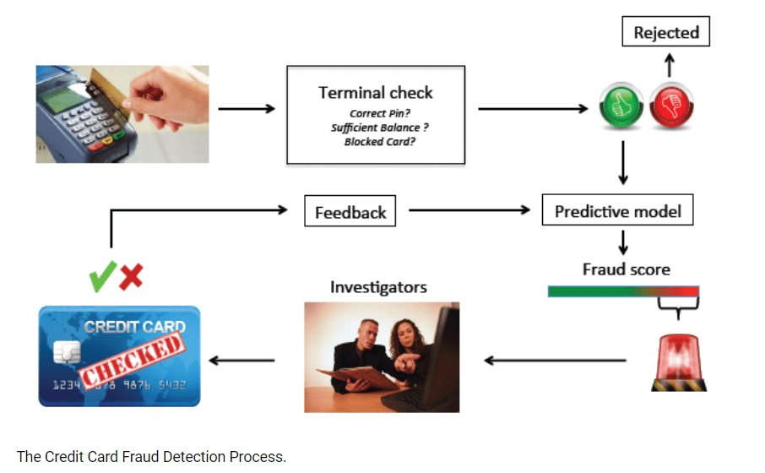
3.2. Fraud Detection Process

Slide 8
4. Technologies Used
4.1. Machine Learning
Machine learning is the scientific study of algorithms and static models that computer systems use in order to perform a specific task effectively without using the explicit instruction, relaying on patterns and interface instead.
Machine learning algorithms build a mathematical model based on a sample data, known as training data in order to make prediction and decisions.
Machine learning algorithms are used in email filtering, face recognition, etc.

Slide 9
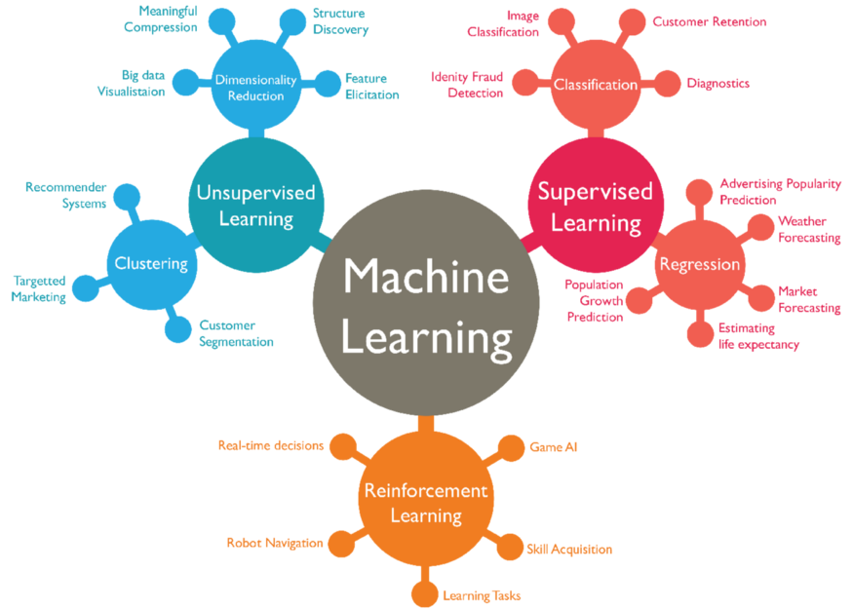
Types of Machine Learning Algorithm

Slide 10
Supervised Learning
Supervised learning as the name indicates the presence of a supervisor as a teacher.
Supervised learning algorithm build a mathematical model of a set of data that contain both input and output.
Basically supervised learned is a learning in which we teach or train the machine using data which is well labelled, that means some data is already tagged with the correct answer.
After that, the machine is provided with a new set of examples(data) so that supervised learning algorithm analyses the training data(set of training examples) and produces a correct outcome from labelled data.

Slide 11
Unsupervised learning
Unsupervised learning is the training of machine using information that is neither classified nor labeled and allowing the algorithm to act on the information without guidance. Here the task of machine is to group unsorted information according to similarities, patterns and differences without any prior training of data.
Unlike supervised learning, no teacher is provided that means no training will be given to the machine. Therefore machine is restricted to find the hidden structure in unlabelled data by ourself.

Slide 12
Reinforcement Learning
Reinforcement learning is an area of machine learning. Reinforcement is about taking suitable action to maximize reward in a particular situation.
It is employed by various software and machines to find the best possible behavior or path it should take in a specific situation.
Reinforcement learning differs from the supervised learning in a way there is no answer key but the reinforcement agent decides what to do to perform the given task.

Slide 13
4.2. Algorithm used
Isolation Forests :The algorithm is based on the fact that anomalies are data points that are few and different.
This method is highly useful and is fundamentally different from all existing methods.
It introduces the use of isolation as a more effective and efficient means to detect anomalies than the commonly used basic distance and density measures. Moreover, this method is an algorithm with a low linear time complexity and a small memory requirement.
Isolation forest algorithm isolates observations by randomly selecting a feature and then randomly selecting a split value between the maximum and minimum values of the selected feature.
Isolating anomaly observations is easier because only a few conditions are needed to separate those cases from the normal observations.

Slide 14
5. Modules
Module 1: Frame the problem
Module 2: Collect the raw data
Download data from Kaggle
Module 3: Import the libraries
Pandas, numpy, sklearn etc.
Module 3: Process the data for analysis.
Perform the logistic regression on data
Explore the data.
Module 5: Perform in-depth analysis.
Module 6: Communicate results of the analysis.

Slide 15
6. Dataset for Credit Card Fraud Detection
The Dataset that is used for credit card fraud detection is derived from the kaggle.
Kaggle is the online community of data scientist and Machine learners.
Kaggke allows users to find and oublish data sets, explore and build models in a web-based data science project and solve challenges.

Slide 16
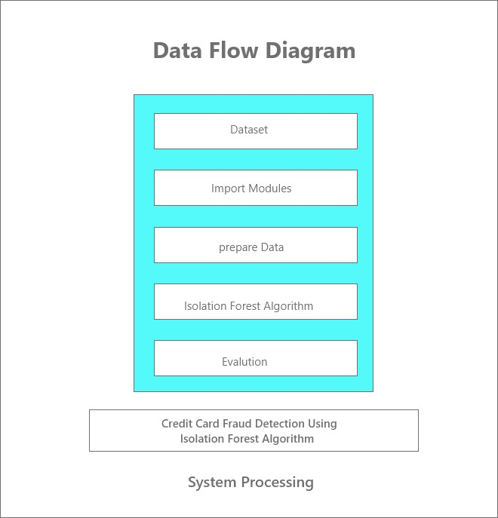
7. Data Flow Diagram

Slide 17
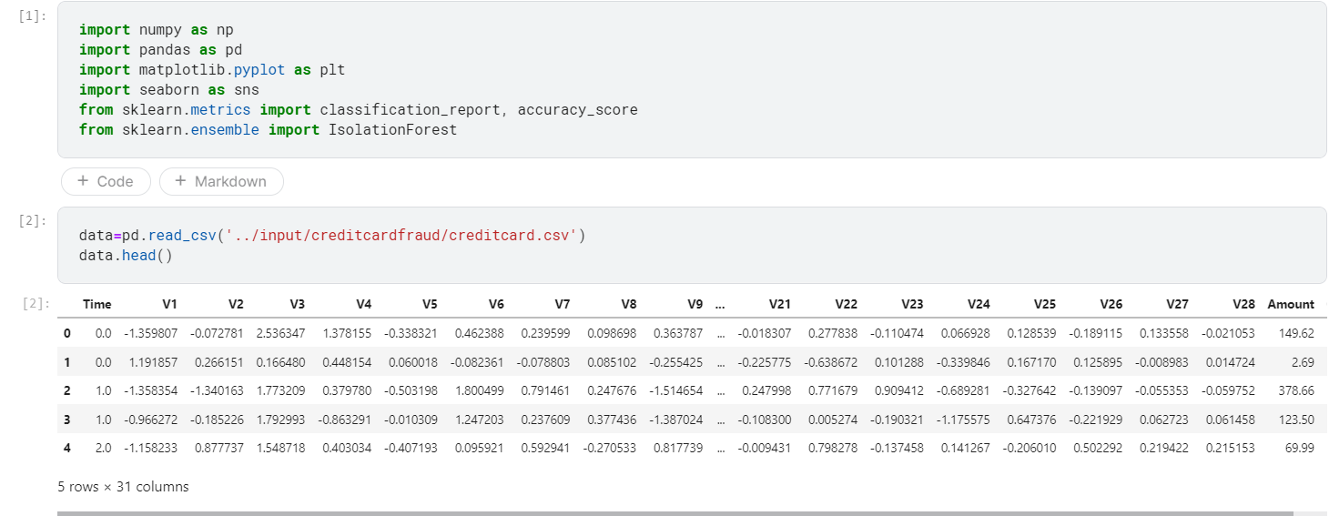
Screenshot:
8. Progress of Application

Slide 18
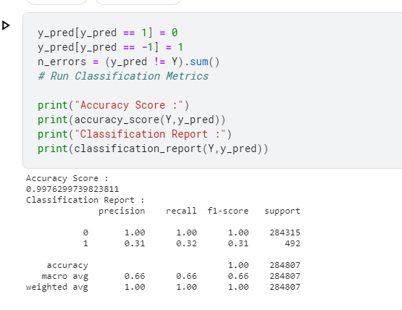
Screenshot:

Slide 19
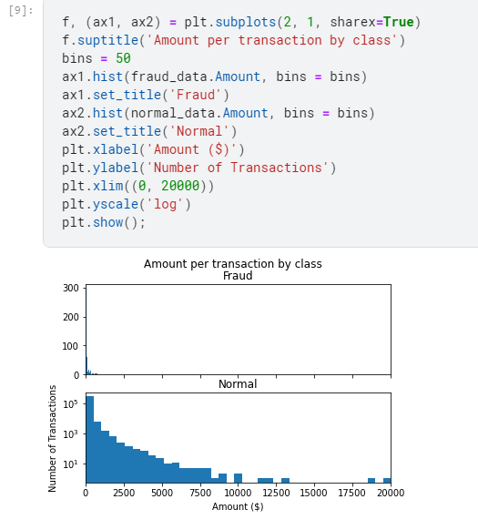
Screenshot:

Slide 20
9. Advantages
Isolation forest not only detects anomalies faster but also requires less memory compared to other anomaly detection algorithms.
Isolation forest works on the principle of the decision tree algorithm. It isolates the outliers by randomly selecting a feature from the given set of features and then randomly selecting a split value between the maximum and minimum values of the selected feature. This random partitioning of features will produce smaller paths in trees for the anomalous data values and distinguish them from the normal set of the data.

Slide 21
10. Conclusion and Future Scope
Fraud Detection system have become essential for banks and financial institution, to minimize their losses.
However, there is a lack of published literature on credit card fraud detection techniques, due to the unavailable credit card transaction dataset for researches.
We designed a system to detect fraud in credit card transaction. This system is capable of providing most of the essential features required to detect fraudulent and legitimate transactions.
The dataset available on day to day processing may become outdated, it is necessary to have updated data for effective fraud behavior identification.

